Slide 1
Data summarization
Data summarization involves presenting a large volume of data in a concise and informative way. The goal is to distill the essential characteristics of the data so that it is easier to understand and analyze. This process can include generating numerical summaries, visualizations, and aggregations that highlight key aspects of the dataset.

Slide 2
common data summarization techniques
Descriptive Statistics
Descriptive statistics summarize the central tendency, dispersion, and shape of a dataset’s distribution. Common measures include the mean, median, mode, standard deviation, and variance.
Example: Summarizing Monthly Expenses

Slide 3
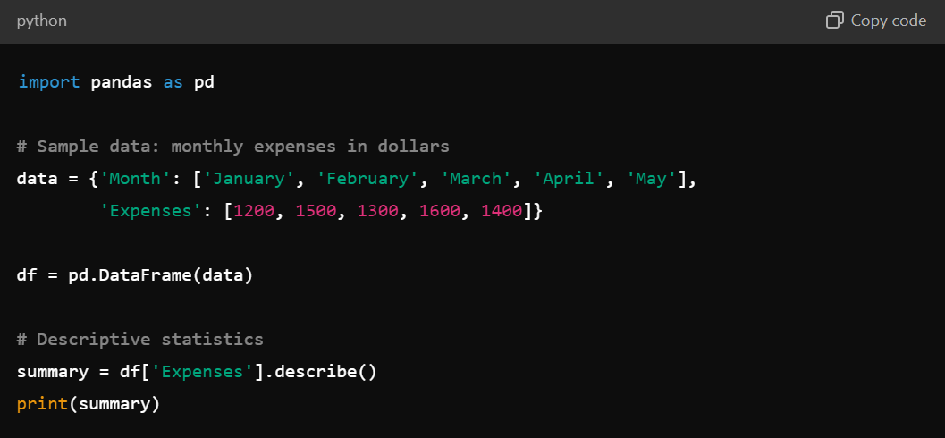

Slide 4
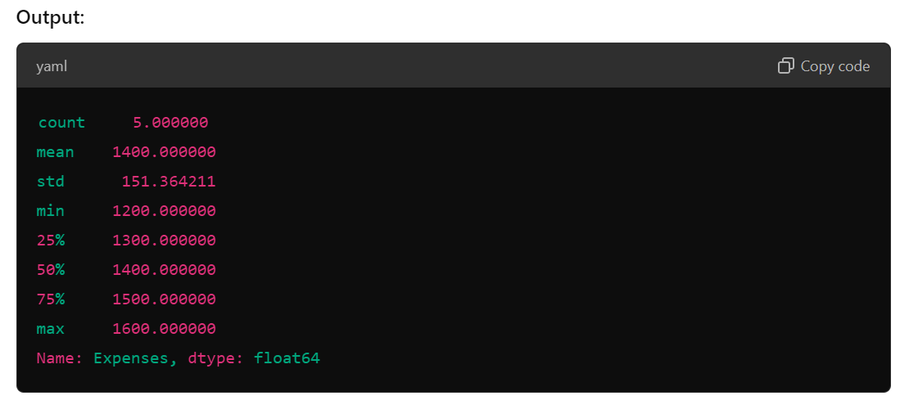

Slide 5
Frequency Distribution
Frequency distribution shows how often each value occurs within a dataset. It is useful for understanding the distribution of categorical data.
Example: Analyzing Favorite Movie Genres

Slide 6
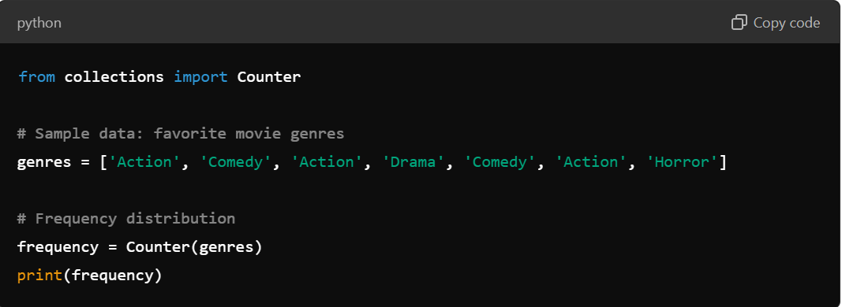

Slide 7
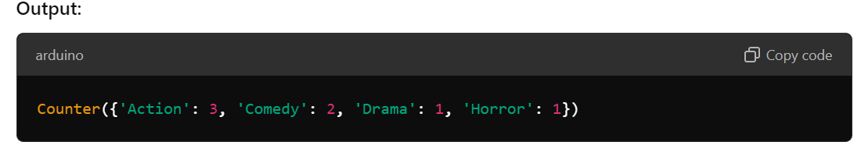

Slide 8
Grouped Statistics
Grouped statistics involve aggregating data based on categories or groups, and calculating summary statistics for each group.
Example: Sales Data by Store

Slide 9
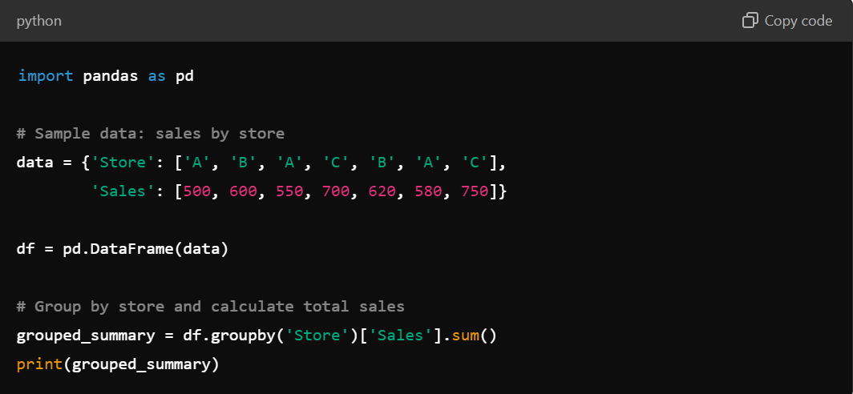

Slide 10
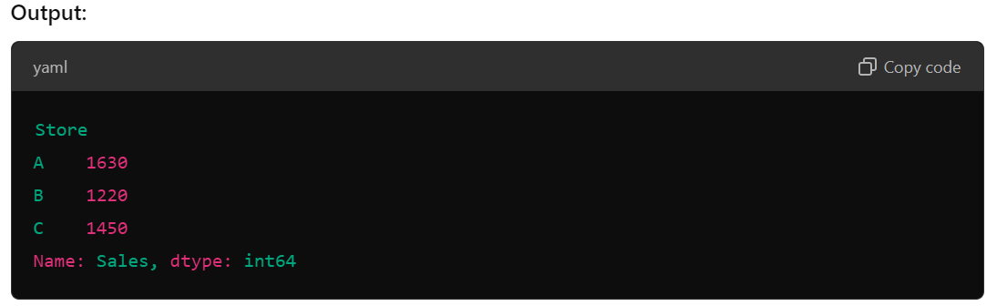

Slide 11
Data Visualization
Visualization techniques help in understanding data patterns and distributions through graphical representations.
Example: Visualizing Monthly Expenses

Slide 12
Correlation Analysis
Correlation analysis measures the strength and direction of relationships between two numerical variables.
Example: Examining the Relationship Between Hours Studied and Exam Scores

Slide 13
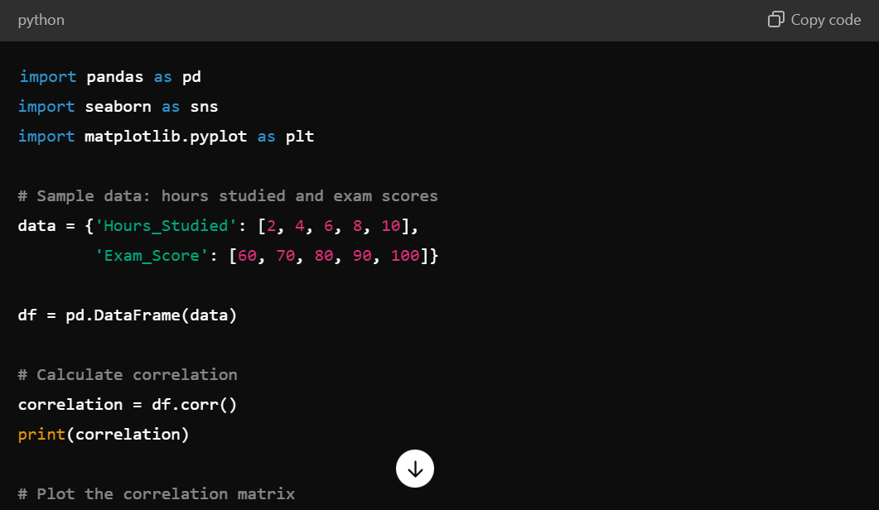

Slide 14


Slide 15
Summary
Descriptive Statistics: Provides measures like mean, median, and standard deviation to summarize the dataset.
Frequency Distribution: Shows the count of occurrences for each category.
Grouped Statistics: Aggregates data by categories and calculates summary statistics like totals or averages.
Data Visualization: Uses charts and plots to visually summarize and interpret data patterns.
Correlation Analysis: Identifies the relationship between two numerical variables.
These techniques are essential for data analysis, helping you to extract meaningful insights and present data effectively. Python libraries like Pandas, Matplotlib, and Seaborn are commonly used to implement these summarization techniques.

